Slide 1

Using Historical Data to Model HIV Prevalence
How Many People are Still in My Jurisdiction?

Slide 2
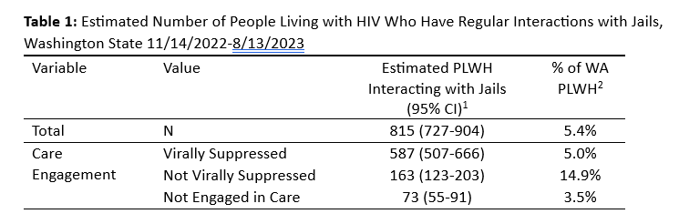
Inspiration: What Proportion of OOC Individuals Pass Through Jails?
Notes:
-Washington has a dataset which can tell us when PLWH enter jail
-We were interested in seeing what % of PLWH enter jail to get an idea of what kind of impact a jail-based relinkage program could have
-However, when we do this, the results don’t make a lot of sense: a high percentage of people who are NVS interact with jails, but only a low percentage of people who are not engaged in care
-This points to possibly a denominator problem: perhaps people who are OOC are not at risk of going to jail because they aren’t in WA.

Slide 3
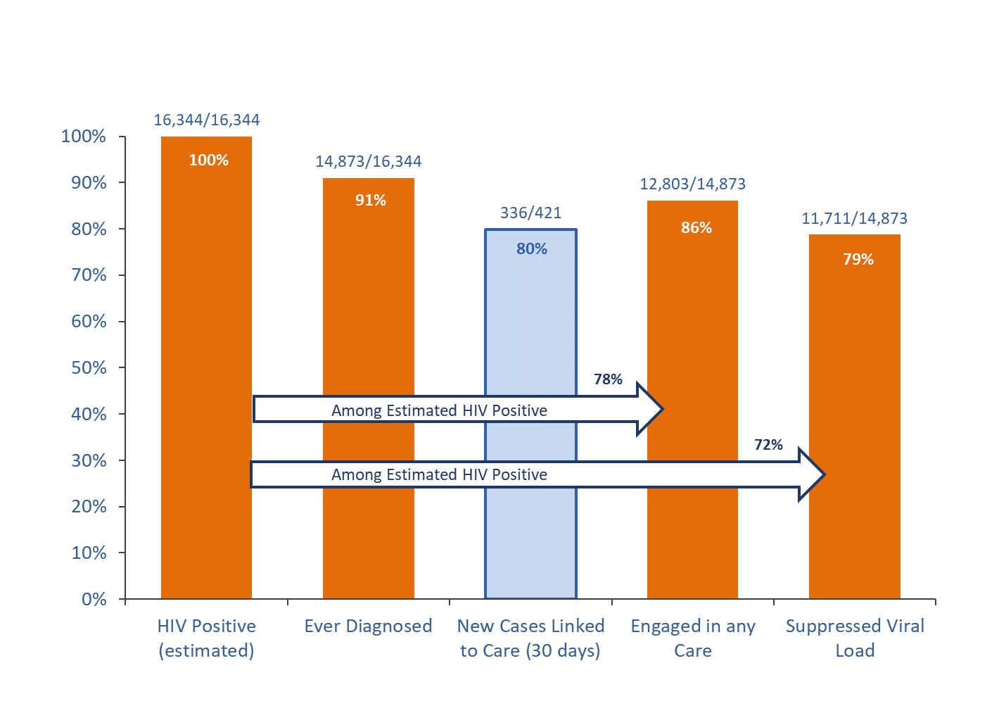
Background
The standard surveillance definition makes strong assumptions that likely overestimate the number of people who are out of care
No labs in past 12 months = not engaged in care
What does it mean if someone hasn’t gotten labs in the past 12 months?
They have disengaged from care
They are still in care but missed a Dr’s appointment
There is a reporting delay
There is a reporting gap
They moved to another state/country
They died

Slide 4
Proposal
We propose to use historical data to refine the assumptions of the CDC out of care estimate for Washington state.
We will:
Estimate the probability that people who appeared out of care between 2014 and 2017 were found to be truly out of care
Use these probabilities as weights to make an estimate of the current HIV prevalence and % virally suppressed in Washington

Slide 5
Methods

Slide 6
Study Population
All people who had a period where they appeared to be out of care between 1/1/2014 and 12/31/2017
12 months from the sample date of a lab to the enter date of the next update about them
Updates could be:
New Lab
Viremic
Suppressed
Out of State Address
Death report

Slide 7
Deriving Probability Weights
As a function of time since a person’s last lab, estimate:
1.) Probability that a person is no longer in jurisdiction (reported in another state or died)
2.) Among those who are still in the jurisdiction, what is the probability that their next lab will be viremic (indicating the person was out of care)?
Stratify by result of last viral load before going out of care

Slide 8
Application to Present Data
Apply the probabilities as weights to current data
For each person who is currently out of care, what is the probability that they are still in WA?
If they are here, what is the probability that they are viremic?
Create new care continuum adjusted for these estimates
Prevalence: Anyone who has had a lab reported to WA in past 10 years

Slide 9
Results

Slide 10
Outcomes of People Who Were OOC, 2014-2017
Outcome | All | Last Lab Viremic | Last Lab Suppressed
Total | 5581 | 2810 | 3071
Died | 552 (9%) | 262 (9%) | 290 (9%)
Reported Out of State | 971 (17%) | 418 (15%) | 553 (18%)
Lab Reported in WA | 1972 (67%) | 1968 (70%) | 1981 (64%)
Never Returned | 409 (7%) | 162 (6%) | 247 (8%)

Slide 11
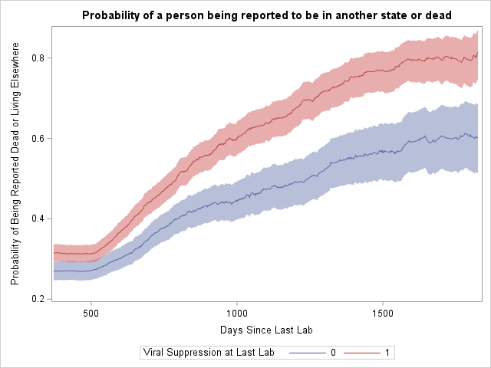

Slide 12
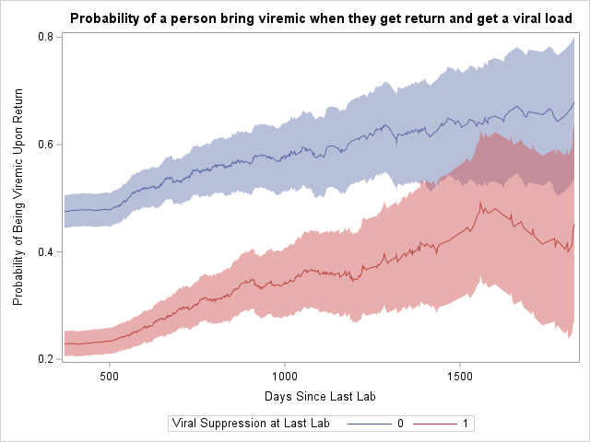

Slide 13
Current State in Washington (12/31/2022)
PLWH in Washington- 15,208
Virally Suppressed-11,927 (78%)
Not virally Suppressed (in care)- 925 (6%)
Out of Care-2356 (15%)
78%

Slide 14
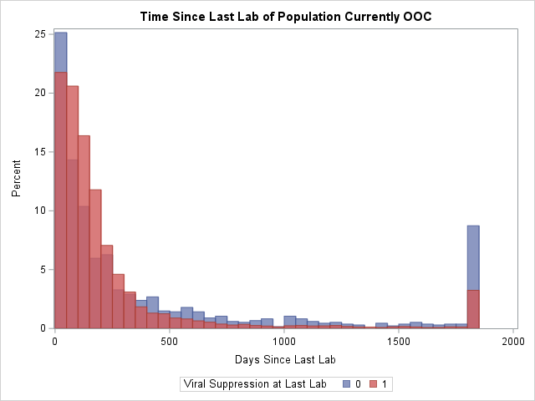

Slide 15
Results
Population | CDC Methods | Estimated
In Care: Suppressed | 11,927 | 11,927
In Care: Viremic | 925 | 925
Out of Care: Suppressed | 0 | 746 (730-762)
Out of Care: Viremic | 2356 | 387 (379-394)
Total | 15,208 | 13,985
% Suppressed | 78% | 91%

Slide 16
Inspiration: What Proportion of OOC Individuals Pass Through Jails?
19.1%

Slide 17
Discussion

Slide 18
Discussion
Our results suggest that only about half of people who appear to be are out of care are still in Washington State.
Of these, only about a third are viremic
This has implications for
Program planning
Epidemic modelling
Setting D2C targets

Slide 19
Limitations
We assume that someone’s final state represents what they were doing the whole time we didn’t see them
E.g. it is possible that someone was OOC in Washington and then moved away
Improvements in surveillance practices (RIDR, D2C) could affect the applicability of historical data
If interstate deduplication is improving, the current OOC population may be more likely to represent people who are in WA

Slide 20
Probability Estimates Over Time

Slide 21
What Do You Think About This Approach?
Do the assumptions seem reasonable?
Is it an improvement over the usual method?
What reservations would you have about sharing these estimates publicly?

Slide 22
Try it Yourself!
https://github.com/sjerly/PrevModel
Opportunity for cross state collaboration?
steven.erly@doh.wa.gov

